Slide 1




What Drives DIY Video Views?
Using Machine Learning to Analyze Popular YouTube Channel Trends
Team 4: Yannis Papadopoulos, Amy Dos Santos, Saloum Bouchaaya, Crystal Gonzales, Zoey Quach
Notes:
Creadit picture : Unsplash Photo by Chris Yang
Link : https://unsplash.com/photos/1BtAeOohu1A Photo by Vidar Nordli-Mathisen
Link : https://unsplash.com/photos/xqMM3KoR7oI

Slide 2

DIY YOUTUBE CHANNELS
Explore
Tools and Libraries
YT API Data Points
Data Preprocessing
ML Predictions
Develop a MLM to analyze DIY YouTube videos
Identify key factors that contribute to video success
Optimize content creation based on model insights
Patterns
Successful Strategies
Challenges/Future
Conclusion
Notes:
Slide 2: Introduction to YouTube API and Machine Learning - Crystal
Key Points:
What is the YouTube API and how does it work? (Access to video, channel, and playlist data).
The importance of understanding what makes a YouTube channel successful.
Goal: Using YouTube API data to advise someone interested in creating a new YouTube channel on what factors lead to popularity and success.
Trying to get a ML model to give us the highest accuracy to predict # of views

Slide 3

Tools and Libraries for Working with YouTube API and ML
Explore
Tools and Libraries
YT API Data Points
Python
Pandas
SciPy
NumPy
YouTube API
JSON
RegEx (regular expression
Data Preprocessing
ML Predictions
Patterns
Successful Strategies
Challenges/Future
Conclusion
Notes:
Slide 2: Introduction to YouTube API and Machine Learning - Zoey or Crystal??
Key Points:
What is the YouTube API and how does it work? (Access to video, channel, and playlist data).
The importance of understanding what makes a YouTube channel successful.
Goal: Using YouTube API data to advise someone interested in creating a new YouTube channel on what factors lead to popularity and success.
Tools and Libraries for Working with YouTube API and ML:
Overview of tools:
Google API to grab Youtube API
Python Pandas
TensorFlow
Scikit-learn: For building and evaluating machine learning models.
Tableau
Seaborn (Heat map graph)

Slide 4
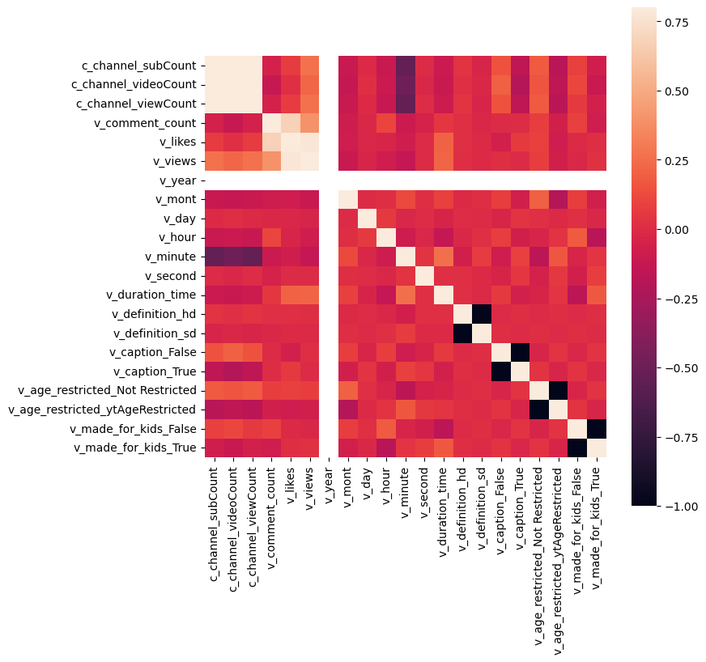

Tools and Libraries for Working with YouTube API and ML
Explore
Tools and Libraries
YT API Data Points
Tableau
Matplotlib
Seaborn
Data Preprocessing
ML Predictions
Patterns
Successful Strategies
Challenges/Future
Conclusion
Notes:
Slide 2: Introduction to YouTube API and Machine Learning - Zoey or Crystal??
Key Points:
What is the YouTube API and how does it work? (Access to video, channel, and playlist data).
The importance of understanding what makes a YouTube channel successful.
Goal: Using YouTube API data to advise someone interested in creating a new YouTube channel on what factors lead to popularity and success.
Tools and Libraries for Working with YouTube API and ML:
Overview of tools:
Google API to grab Youtube API
Python Pandas
TensorFlow
Scikit-learn: For building and evaluating machine learning models.
Tableau
Seaborn (Heat map graph)

Slide 5

Tools and Libraries for Working with YouTube API and ML
Explore
Tools and Libraries
YT API Data Points
Scikit-learn
XGBoost
TensorFlow
Data Preprocessing
ML Predictions
Patterns
Successful Strategies
Challenges/Future
Conclusion
Notes:
Slide 2: Introduction to YouTube API and Machine Learning - Zoey or Crystal??
Key Points:
What is the YouTube API and how does it work? (Access to video, channel, and playlist data).
The importance of understanding what makes a YouTube channel successful.
Goal: Using YouTube API data to advise someone interested in creating a new YouTube channel on what factors lead to popularity and success.
Tools and Libraries for Working with YouTube API and ML:
Overview of tools:
Google API to grab Youtube API
Python Pandas
TensorFlow
Scikit-learn: For building and evaluating machine learning models.
Tableau
Seaborn (Heat map graph)

Slide 6

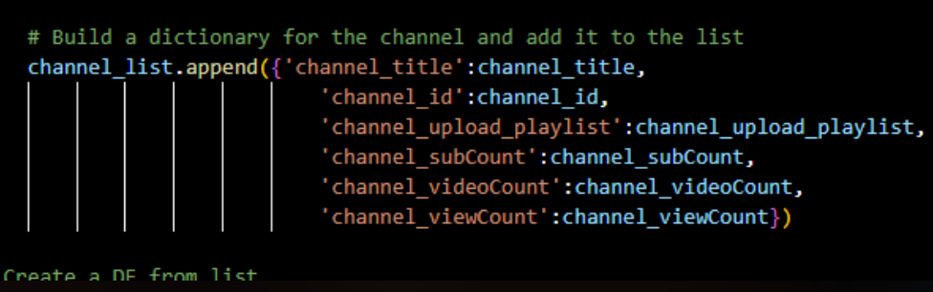
Data Points from the YouTube API
Explore
Tools and Libraries
YT API Data Points
Learn YouTube API
Find key Video and Channel data needed
Retrieved data from DIY channels using API
Pull Channel data
Pull Video data
Data Preprocessing
ML Predictions
Patterns
Successful Strategies
Challenges/Future
Conclusion
EDIT PROFILE
SHARE
Notes:
Key Data Points from the YouTube API - Yannis
Key Points:
Overview of important data available through the YouTube API:
Video data: View count, like/dislike ratio, comments, video description, etc.
Channel data: Subscriber count, content type, frequency of uploads, etc.
Engagement metrics: Comments, likes, and shares.
The problem: A person wants to create a YouTube channel and needs advice on what factors contribute to success.
Insert Graph Section:
Placeholder for a bar chart or scatter plot comparing successful YouTube channels with varying engagement metrics (views, likes, comments).

Slide 7
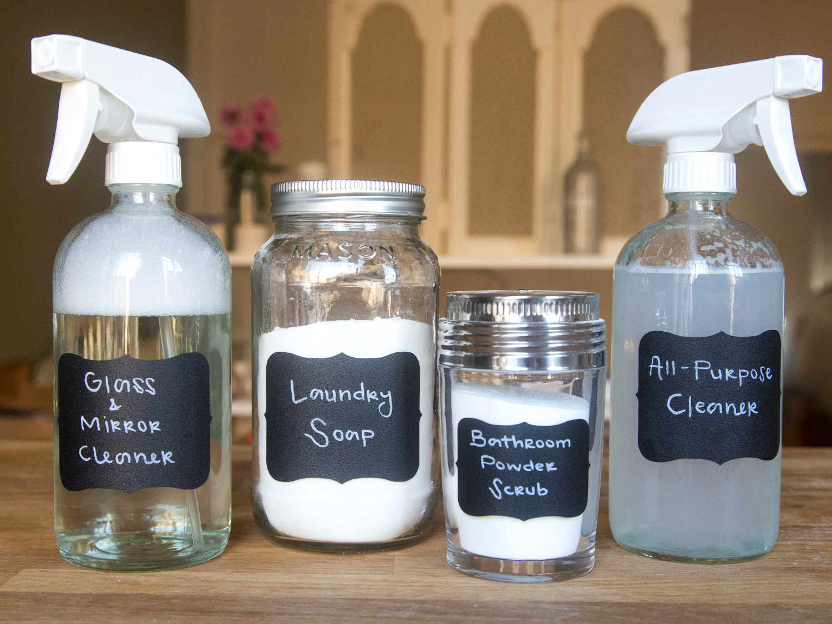
Preprocessing - Phase 1
Explore
Tools and Libraries
Cleaning data
Filtering Data
No Scaling Needed
Final Cleaned Dataset
YT API Data Points
Data Preprocessing
ML Predictions
Patterns
Successful Strategies
Challenges/Future
Conclusion
Notes:
Data Preprocessing with YouTube API Data - Yannis
Key Points:
Data cleaning and preprocessing steps:
Handling missing data (e.g., missing views, likes).
Normalizing data (scaling features like views, likes, and subscribers).
Encoding categorical variables (e.g., video category, content type).
Preparing the data for training machine learning models.
Insert Graph Section:
Placeholder for a flowchart of the data preprocessing pipeline, including steps like cleaning, normalization, and encoding
Flowchart - get API key, then get channel IDs, made API calls to get channel IDs that are related to “DIY”
Get data from the channels, channel specific data, included channel name, playlists, sub count, view count,

Slide 8
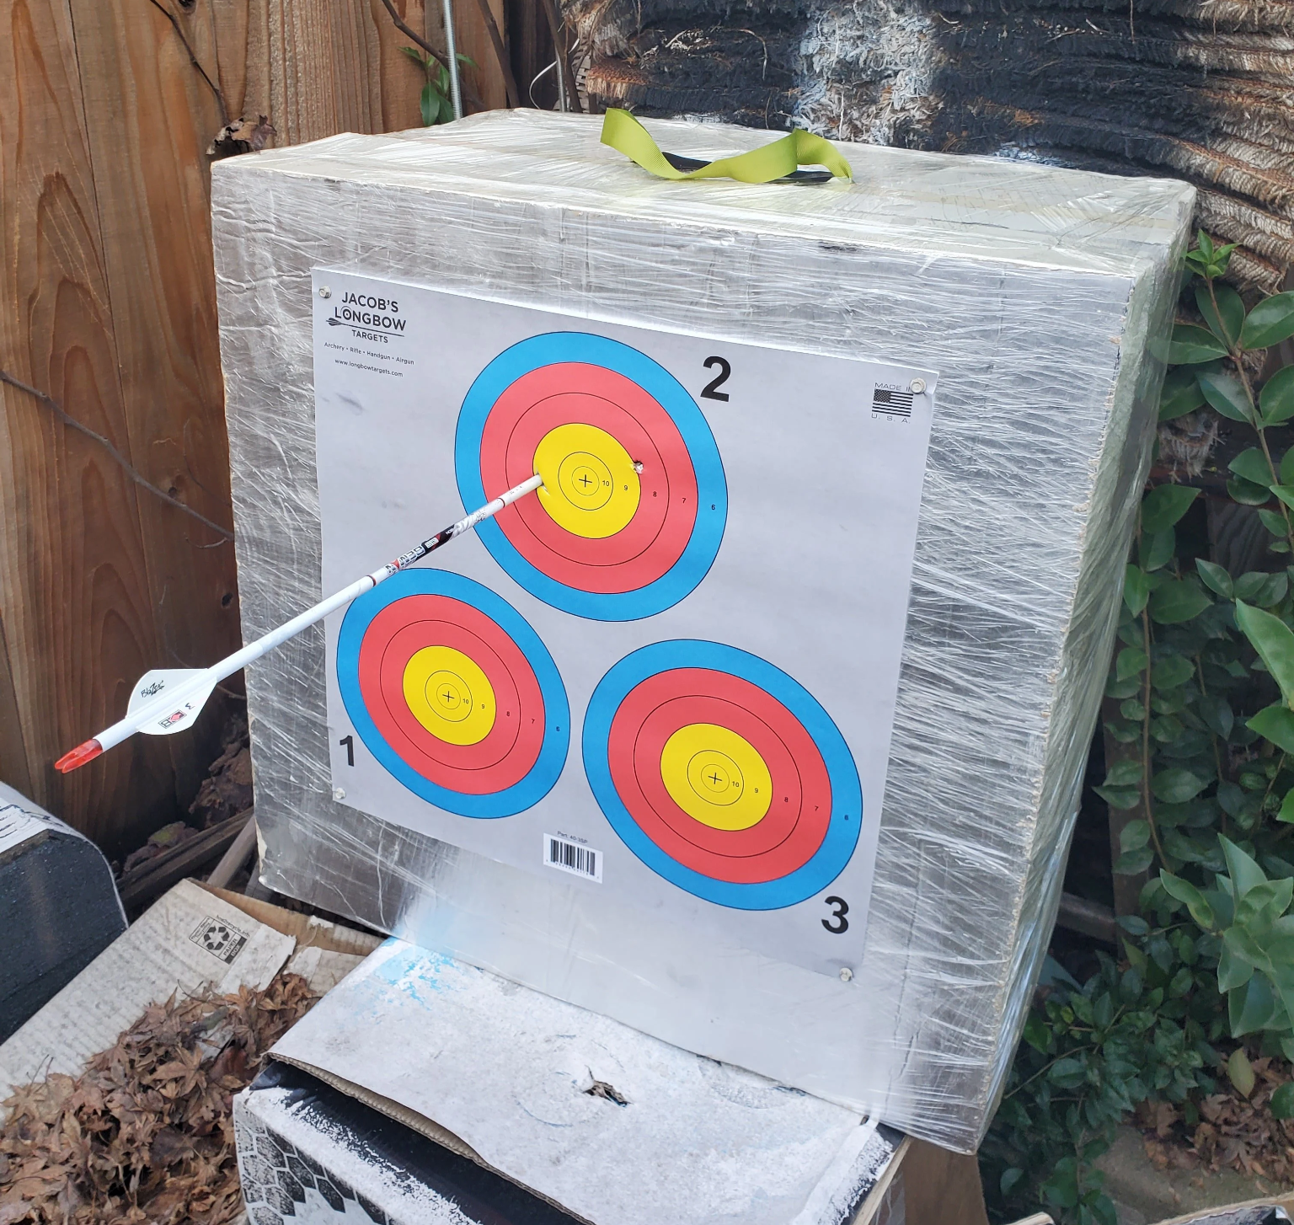
Preprocessing - Phase 2
Explore
Tools and Libraries
1️⃣ Target variable → Binning
labels= ["Very Low (0 - 1K)",
"Low (1K - 5K)",
"Moderate (5K - 10K)",
"Growing (10K - 50K)",
"Established (50K - 100K)",
"Popular (100K - 500K)",
"Trending (500K - 1M)",
"Viral (1M+)"]
2️⃣Numerical columns → Transforming data types
3️⃣ Text columns → CountVectorizer to extract meaningful words
4️⃣ Encoding → Get dummies for non-numerical columns
YT API Data Points
Data Preprocessing
ML Predictions
Patterns
Successful Strategies
Challenges/Future
Conclusion
Notes:
Data Preprocessing Phase 2: Transforming target variable and Features
Key Points:
Data cleaning and preprocessing steps:
Handling missing data (e.g., missing views, likes).
Normalizing data (scaling features like views, likes, and subscribers).
Encoding categorical variables (e.g., video category, content type).
Preparing the data for training machine learning models.
Insert Graph Section:
Placeholder for a flowchart of the data preprocessing pipeline, including steps like cleaning, normalization, and encoding
Flowchart - get API key, then get channel IDs, made API calls to get channel IDs that are related to “DIY”
Get data from the channels, channel specific data, included channel name, playlists, sub count, view count,

Slide 9
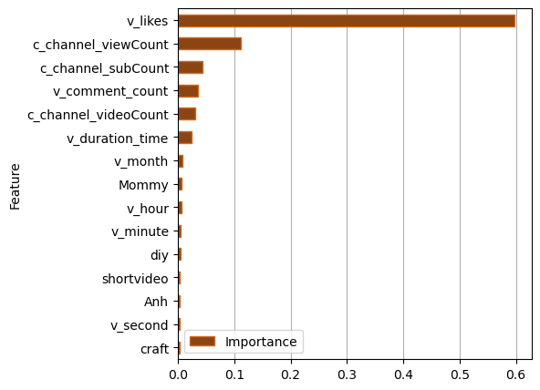
ML Models
Explore
Decision Tree: 69.53% accuracy
Tools and Libraries
YT API Data Points
Data Preprocessing
ML Models
Patterns
Successful Strategies
Challenges/Future
Conclusion
Notes:
ML Models: Decision Tree
Using Machine Learning to Predict Success Factors - Amy
Key Points:
Machine Learning Goal: Build a predictive model to suggest optimal strategies for a new YouTube channel based on data from successful channels.
Using Scikit-learn to implement models that predict:
Likely video success based on factors like title length, description, tags, and upload time.
Best video content type (e.g., tutorial, vlog, product review).
Example Dataset: Channel data from the YouTube API with over 100 records (e.g., a mix of popular and less popular channels).
Insert Graph Section:
Placeholder for a confusion matrix or ROC curve to evaluate model performance predicting video success based on different features (upload frequency, content type, etc.).
Most likes vs when they were uploaded
Decision Tree
Random Forest
Neural Network

Slide 10
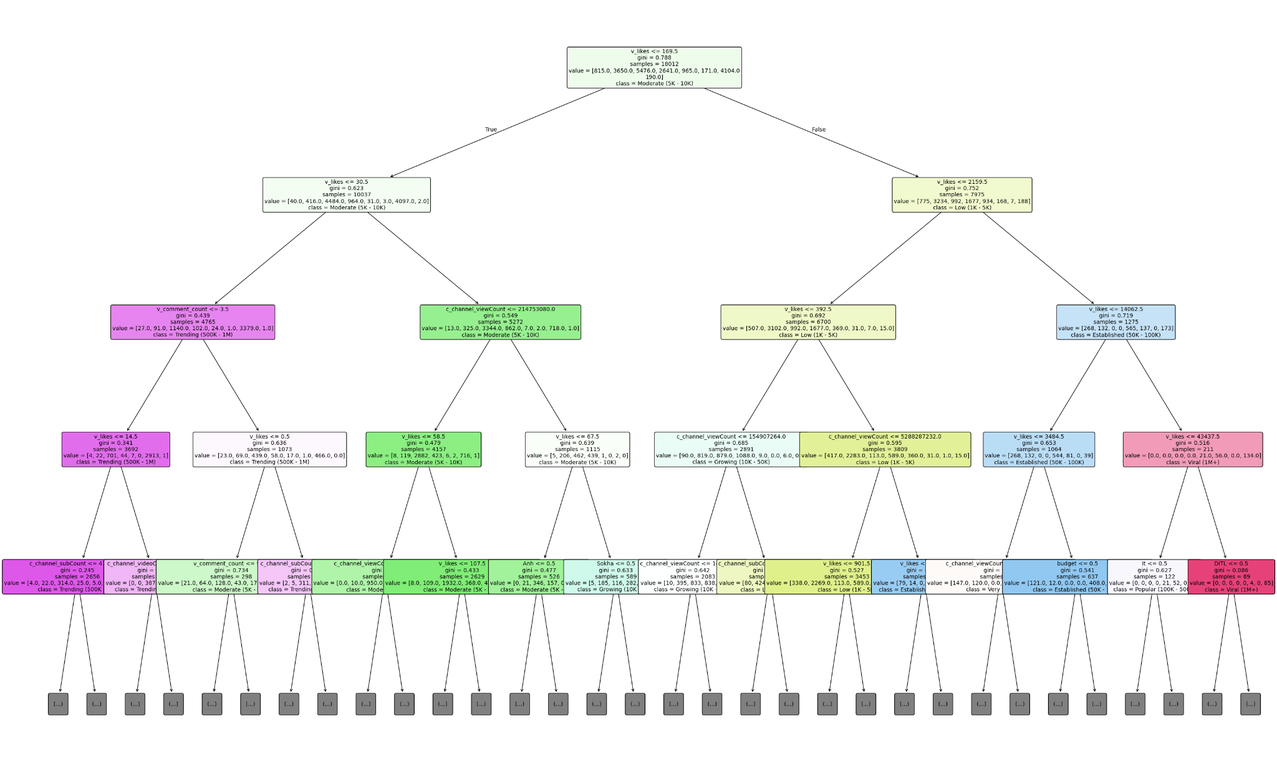
ML Models
Explore
Decision Tree:
Tools and Libraries
YT API Data Points
Data Preprocessing
ML Models
Patterns
Successful Strategies
Challenges/Future
Conclusion
Notes:
ML Model: Decision Tree figure 1
Using Machine Learning to Predict Success Factors - Amy
Key Points:
Machine Learning Goal: Build a predictive model to suggest optimal strategies for a new YouTube channel based on data from successful channels.
Using Scikit-learn to implement models that predict:
Likely video success based on factors like title length, description, tags, and upload time.
Best video content type (e.g., tutorial, vlog, product review).
Example Dataset: Channel data from the YouTube API with over 100 records (e.g., a mix of popular and less popular channels).
Insert Graph Section:
Placeholder for a confusion matrix or ROC curve to evaluate model performance predicting video success based on different features (upload frequency, content type, etc.).
Most likes vs when they were uploaded
Decision Tree
Random Forest
Neural Network

Slide 11
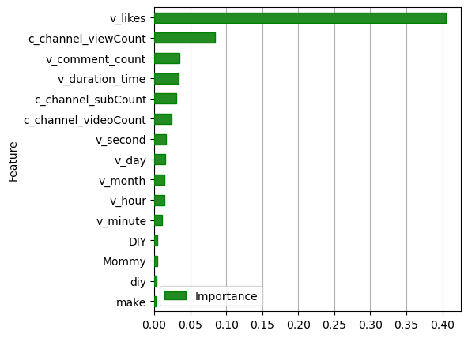
ML Models
Explore
Random Forest: 74.96%
Tools and Libraries
YT API Data Points
Data Preprocessing
ML Models
Patterns
Successful Strategies
Challenges/Future
Conclusion
Notes:
ML Models: Random Forest
Using Machine Learning to Predict Success Factors - Amy
Key Points:
Machine Learning Goal: Build a predictive model to suggest optimal strategies for a new YouTube channel based on data from successful channels.
Using Scikit-learn to implement models that predict:
Likely video success based on factors like title length, description, tags, and upload time.
Best video content type (e.g., tutorial, vlog, product review).
Example Dataset: Channel data from the YouTube API with over 100 records (e.g., a mix of popular and less popular channels).
Insert Graph Section:
Placeholder for a confusion matrix or ROC curve to evaluate model performance predicting video success based on different features (upload frequency, content type, etc.).
Most likes vs when they were uploaded
Decision Tree
Random Forest
Neural Network

Slide 12
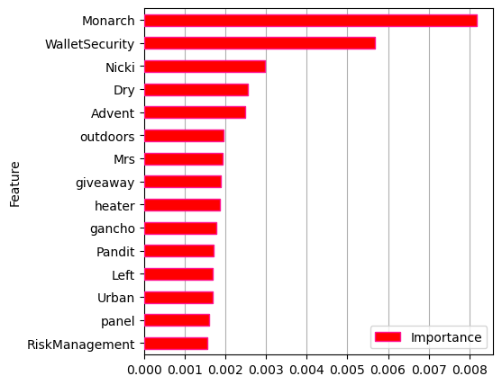
ML Models
Explore
XGBoost: 74.09%
Tools and Libraries
YT API Data Points
Data Preprocessing
ML Models
Patterns
Successful Strategies
Challenges/Future
Conclusion
Notes:
ML Models: XGBoost
Using Machine Learning to Predict Success Factors - Amy
Key Points:
Machine Learning Goal: Build a predictive model to suggest optimal strategies for a new YouTube channel based on data from successful channels.
Using Scikit-learn to implement models that predict:
Likely video success based on factors like title length, description, tags, and upload time.
Best video content type (e.g., tutorial, vlog, product review).
Example Dataset: Channel data from the YouTube API with over 100 records (e.g., a mix of popular and less popular channels).
Insert Graph Section:
Placeholder for a confusion matrix or ROC curve to evaluate model performance predicting video success based on different features (upload frequency, content type, etc.).
Most likes vs when they were uploaded
Decision Tree
Random Forest
Neural Network

Slide 13

ML Models
Explore
XGBoost
Tools and Libraries
YT API Data Points
Excluding Features for more tuning
No text columns:
Better accuracy: 74.56%
No numerical columns:
Worst accuracy: 56.53%
Data Preprocessing
ML Models
Patterns
Successful Strategies
Challenges/Future
Conclusion
Notes:
Slide 5: ML Predictions
Using Machine Learning to Predict Success Factors - Amy
Key Points:
Machine Learning Goal: Build a predictive model to suggest optimal strategies for a new YouTube channel based on data from successful channels.
Using Scikit-learn to implement models that predict:
Likely video success based on factors like title length, description, tags, and upload time.
Best video content type (e.g., tutorial, vlog, product review).
Example Dataset: Channel data from the YouTube API with over 100 records (e.g., a mix of popular and less popular channels).
Insert Graph Section:
Placeholder for a confusion matrix or ROC curve to evaluate model performance predicting video success based on different features (upload frequency, content type, etc.).
Most likes vs when they were uploaded
Decision Tree
Random Forest
Neural Network

Slide 14
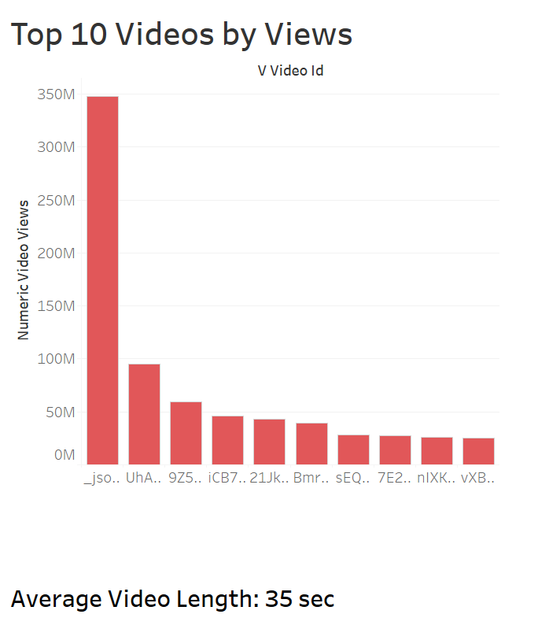
Patterns
Explore
Tools and Libraries
YT API Data Points
Data Preprocessing
ML Predictions
Patterns
Successful Strategies
Challenges/Future
Conclusion
Notes:
Identifying Patterns in Successful Channels - Saloum
Key Points:
Use the YouTube API data to identify patterns in successful channels:
What types of videos tend to get the most views?
How frequently do successful channels post new content?
What kind of engagement (likes, shares, comments) correlates with higher subscriber counts?
Example Problem: Analyze data from channels with over 1 million subscribers and find trends in video length, topic, and frequency of uploads.
Insert Graph Section:
Placeholder for a graph analyzing the frequency of uploads vs. total views for channels with different levels of success (e.g., 10k subscribers vs. 1M+ subscribers).
**Bar graph of most popular videos which ended up being shorts, seconds long**

Slide 15
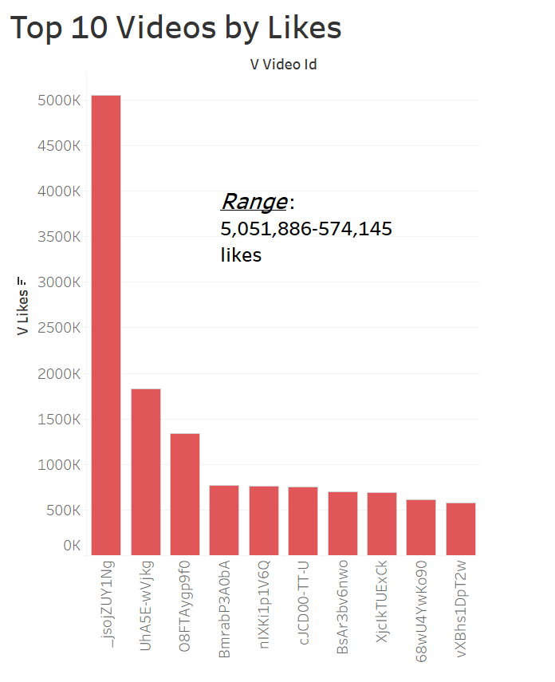
Patterns
Explore
Tools and Libraries
YT API Data Points
Data Preprocessing
ML Predictions
Patterns
Successful Strategies
Challenges/Future
Conclusion
Notes:
Identifying Patterns in Successful Channels - Saloum
Key Points:
Use the YouTube API data to identify patterns in successful channels:
What types of videos tend to get the most views?
How frequently do successful channels post new content?
What kind of engagement (likes, shares, comments) correlates with higher subscriber counts?
Example Problem: Analyze data from channels with over 1 million subscribers and find trends in video length, topic, and frequency of uploads.
Insert Graph Section:
Placeholder for a graph analyzing the frequency of uploads vs. total views for channels with different levels of success (e.g., 10k subscribers vs. 1M+ subscribers).
**Bar graph of most popular videos which ended up being shorts, seconds long**

Slide 16
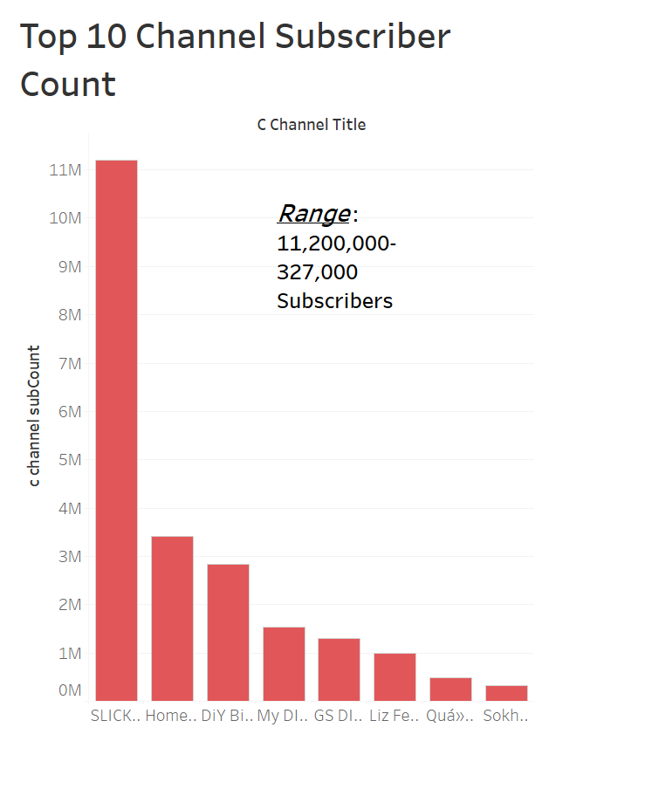
Patterns
Explore
Tools and Libraries
YT API Data Points
Data Preprocessing
ML Predictions
Patterns
Successful Strategies
Challenges/Future
Conclusion
Notes:
Identifying Patterns in Successful Channels - Saloum
Key Points:
Use the YouTube API data to identify patterns in successful channels:
What types of videos tend to get the most views?
How frequently do successful channels post new content?
What kind of engagement (likes, shares, comments) correlates with higher subscriber counts?
Example Problem: Analyze data from channels with over 1 million subscribers and find trends in video length, topic, and frequency of uploads.
Insert Graph Section:
Placeholder for a graph analyzing the frequency of uploads vs. total views for channels with different levels of success (e.g., 10k subscribers vs. 1M+ subscribers).
**Bar graph of most popular videos which ended up being shorts, seconds long**

Slide 17
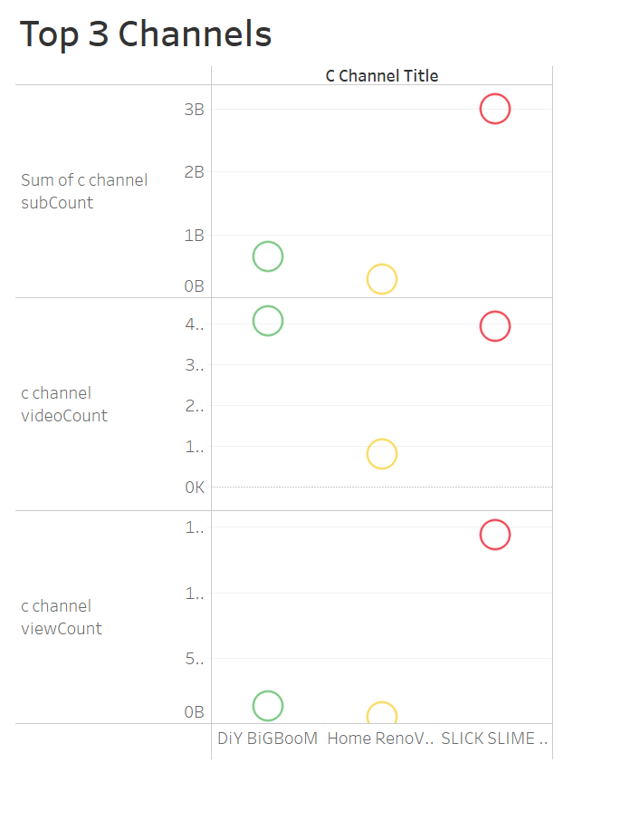
Music
Gaming
News
Movies
Successful Channel Strategy
Explore
Tools and Libraries
YT API Data Points
Data Preprocessing
ML Predictions
Patterns
Successful Strategies
Challenges/Future
Conclusion
Notes:
Slide 7: Successful Strategies
Example of a Successful Channel Strategy Using YouTube Data - Saloum
Key Points:
Case Study: Analyze popular channels in niches like gaming, tech, or beauty using YouTube API data.
Insights from the data:
Which video titles, descriptions, and tags lead to better visibility.
Optimal video length and frequency of uploads.
Recommendation: Advise a new creator to focus on creating tutorial videos, posting 2-3 times a week, and optimizing video titles with relevant keywords.
Insert Graph Section:
Placeholder for a bar chart or line graph comparing engagement metrics (views, likes, comments) for different video content types or upload schedules.
Top 2 channels - specific data for those top two channels
Most subscribers
Upload schedules (dates published)
Video duration vs likes
How well videos do if shorter vs longer
Ex. DIY Pattern? (more than 1 million subscribers)

Slide 18
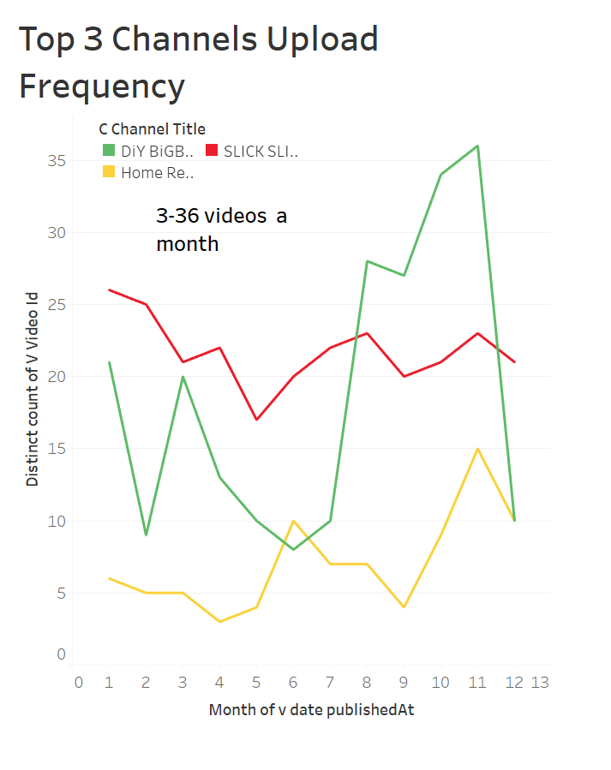
Music
Gaming
News
Movies
Successful Channel Strategy
Explore
Tools and Libraries
YT API Data Points
Data Preprocessing
ML Predictions
Patterns
Successful Strategies
Challenges/Future
Conclusion
Notes:
Slide 7: Successful Strategies
Example of a Successful Channel Strategy Using YouTube Data - Saloum
Key Points:
Case Study: Analyze popular channels in niches like gaming, tech, or beauty using YouTube API data.
Insights from the data:
Which video titles, descriptions, and tags lead to better visibility.
Optimal video length and frequency of uploads.
Recommendation: Advise a new creator to focus on creating tutorial videos, posting 2-3 times a week, and optimizing video titles with relevant keywords.
Insert Graph Section:
Placeholder for a bar chart or line graph comparing engagement metrics (views, likes, comments) for different video content types or upload schedules.
Top 2 channels - specific data for those top two channels
Most subscribers
Upload schedules (dates published)
Video duration vs likes
How well videos do if shorter vs longer
Ex. DIY Pattern? (more than 1 million subscribers)

Slide 19
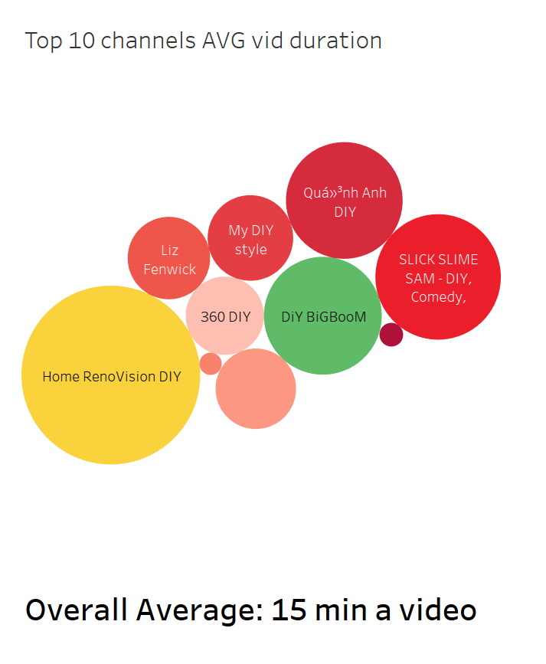
Music
Gaming
News
Movies
Successful Channel Strategy
Explore
Tools and Libraries
YT API Data Points
Data Preprocessing
ML Predictions
Patterns
Successful Strategies
Challenges/Future
Conclusion
Notes:
Slide 7: Successful Strategies
Example of a Successful Channel Strategy Using YouTube Data - Saloum
Key Points:
Case Study: Analyze popular channels in niches like gaming, tech, or beauty using YouTube API data.
Insights from the data:
Which video titles, descriptions, and tags lead to better visibility.
Optimal video length and frequency of uploads.
Recommendation: Advise a new creator to focus on creating tutorial videos, posting 2-3 times a week, and optimizing video titles with relevant keywords.
Insert Graph Section:
Placeholder for a bar chart or line graph comparing engagement metrics (views, likes, comments) for different video content types or upload schedules.
Top 2 channels - specific data for those top two channels
Most subscribers
Upload schedules (dates published)
Video duration vs likes
How well videos do if shorter vs longer
Ex. DIY Pattern? (more than 1 million subscribers)

Slide 20
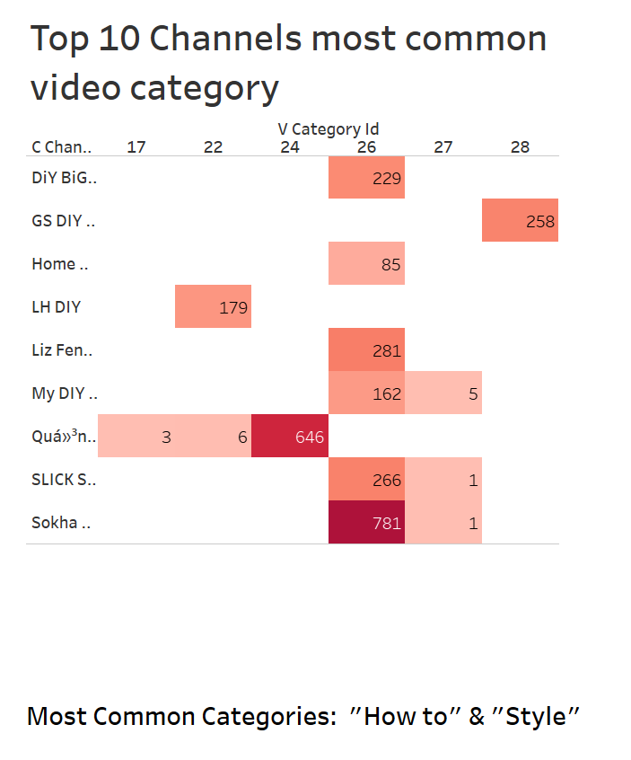
Music
Gaming
News
Movies
Successful Channel Strategy
Explore
Tools and Libraries
YT API Data Points
Data Preprocessing
ML Predictions
Patterns
Successful Strategies
Challenges/Future
Conclusion
Notes:
Slide 7: Successful Strategies
Example of a Successful Channel Strategy Using YouTube Data - Saloum
Key Points:
Case Study: Analyze popular channels in niches like gaming, tech, or beauty using YouTube API data.
Insights from the data:
Which video titles, descriptions, and tags lead to better visibility.
Optimal video length and frequency of uploads.
Recommendation: Advise a new creator to focus on creating tutorial videos, posting 2-3 times a week, and optimizing video titles with relevant keywords.
Insert Graph Section:
Placeholder for a bar chart or line graph comparing engagement metrics (views, likes, comments) for different video content types or upload schedules.
Top 2 channels - specific data for those top two channels
Most subscribers
Upload schedules (dates published)
Video duration vs likes
How well videos do if shorter vs longer
Ex. DIY Pattern? (more than 1 million subscribers)

Slide 21

Explore
Challenges of Using YouTube Data for Predictions
Tools and Libraries
YT API Data Points
API Limits
Data Preprocessing
Error Handling for API Calls
ML Predictions
Patterns
Determine Worthy Data to Pull
Successful Strategies
Challenges/Future
Which Model Worked Best
Conclusion
Notes:
Zoey
Challenges
Key Points:
API limits and learning how to use Youtube's API calls
Error handling for API calls
ChatGPT helped for resolving this issue
Figure out what are worth pulling data for
What model should we use (took a lot of time to try diff models, and some models we were surprised ended up working better than the original ones we chose)
Hypertuning
Messing with features to get best results
lots of error handling (running into code errors and how to fix it)
dealing with different languages, emojis, and links (junk text)

Slide 22

Explore
Challenges of Using YouTube Data for Predictions
Tools and Libraries
YT API Data Points
Hypertuning
Data Preprocessing
Adjusting Features for Best Results
ML Predictions
Patterns
Handful of Error Handling
Successful Strategies
Challenges/Future
Handling Different Languages,
Emojis and Links
Conclusion
Notes:
Zoey
Challenges
Key Points:
API limits and learning how to use Youtube's API calls
Error handling for API calls
ChatGPT helped for resolving this issue
Figure out what are worth pulling data for
What model should we use (took a lot of time to try diff models, and some models we were surprised ended up working better than the original ones we chose)
Hypertuning
Messing with features to get best results
lots of error handling (running into code errors and how to fix it)
dealing with different languages, emojis, and links (junk text)

Slide 23
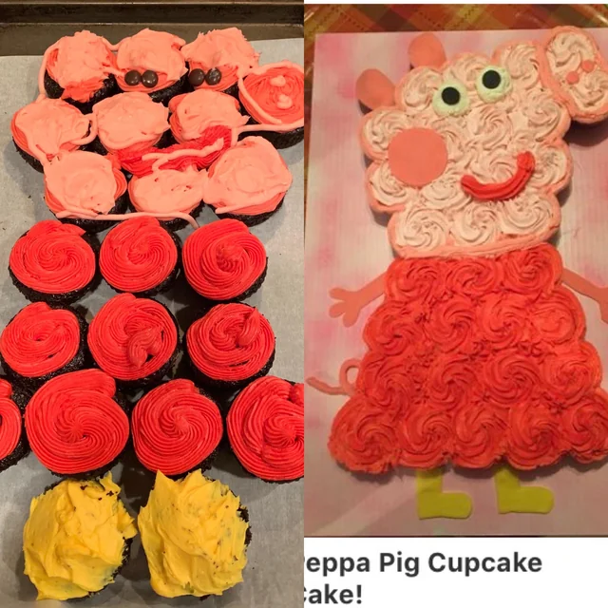
Explore
Future Improvements in YouTube and Machine Learning
Tools and Libraries
YT API Data Points
Higher Accuracy Score
Data Preprocessing
Build Flask/Website That
Gives Success Metrics
ML Predictions
Patterns
Which Feature Is More Important\
Successful Strategies
Challenges/Future
Curate Data Better
Conclusion
Notes:
Zoey
Challenges
Key Points:
API limits and learning how to use Youtube's API calls
Error handling for API calls
ChatGPT helped for resolving this issue
Figure out what are worth pulling data for
What model should we use (took a lot of time to try diff models, and some models we were surprised ended up working better than the original ones we chose)
Hypertuning
Messing with features to get best results
lots of error handling (running into code errors and how to fix it)
dealing with different languages, emojis, and links (junk text)

Slide 24

Explore
Tools and Libraries
Key Points:
YT API Data Points
Data Preprocessing
ML Predictions
Interactions With Videos Are Key
Post More Frequently
Use Popular Trend Ideas
Patterns
Successful Strategies
Challenges/Future
Conclusion
Notes:
Zoey
Feature_importance helps show what features are most important on your video
Posting more frequently
Piggybacking on other ideas (maybe popular trending ideas)

Slide 25
THANK
YOU
Questions?

